Slide 1
Resume-Based Career Explorer
Ying Yu
ying.yu@mg.thedataincubator.com
The Data Incubator Capstone Showcase
August 10, 2023
Notes:
Hi everyone, I’m Ying. I was trained as a cognitive psychologist, and I stayed in academia for the past 9 years.
Recently, I decided to make a career transition into industry.
But I really don’t know what types of industry jobs I can do.

Slide 2
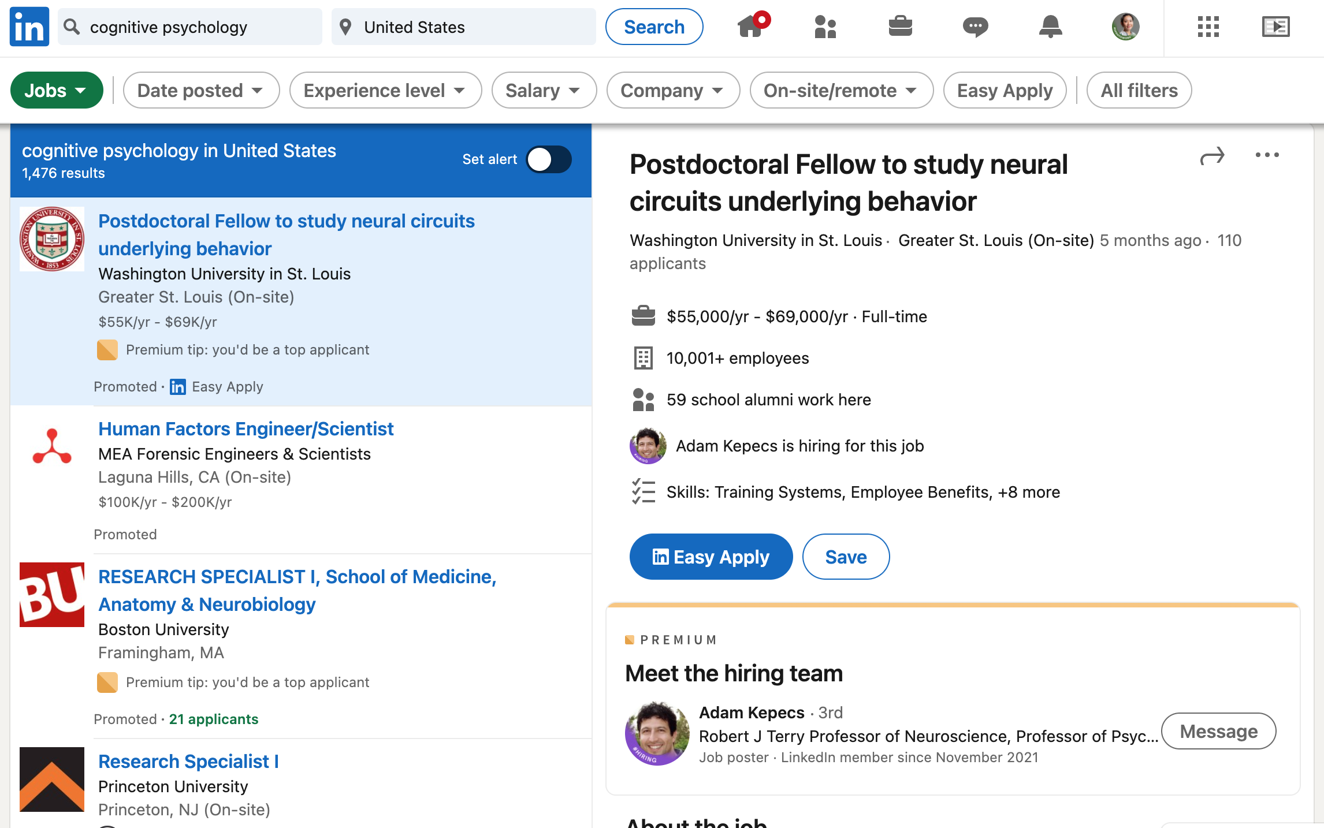
Notes:
So I used Linkedin to explore careers that might fit my background and interest.
But I’m not too happy with Linkedin b/c the search prompt is limited to a few key words.
And I don’t have the time and patience to go through this thousands of individual job posts

Slide 3

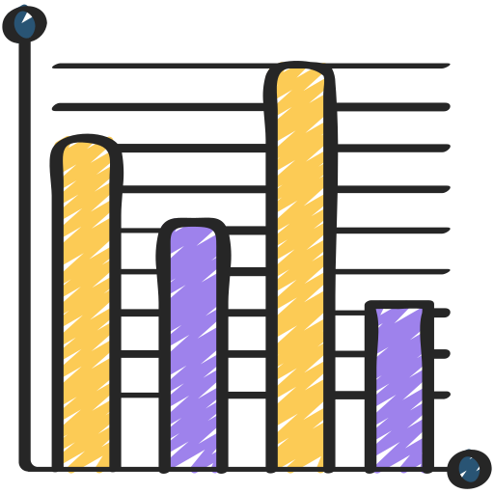

Resume-Based Career Explorer
Matched job categories
Notes:
And THAT motivates me to build a resume-based career explorer
Which take the user uploaded resume as the input,
And return the types of jobs that matched to this resume

Slide 4
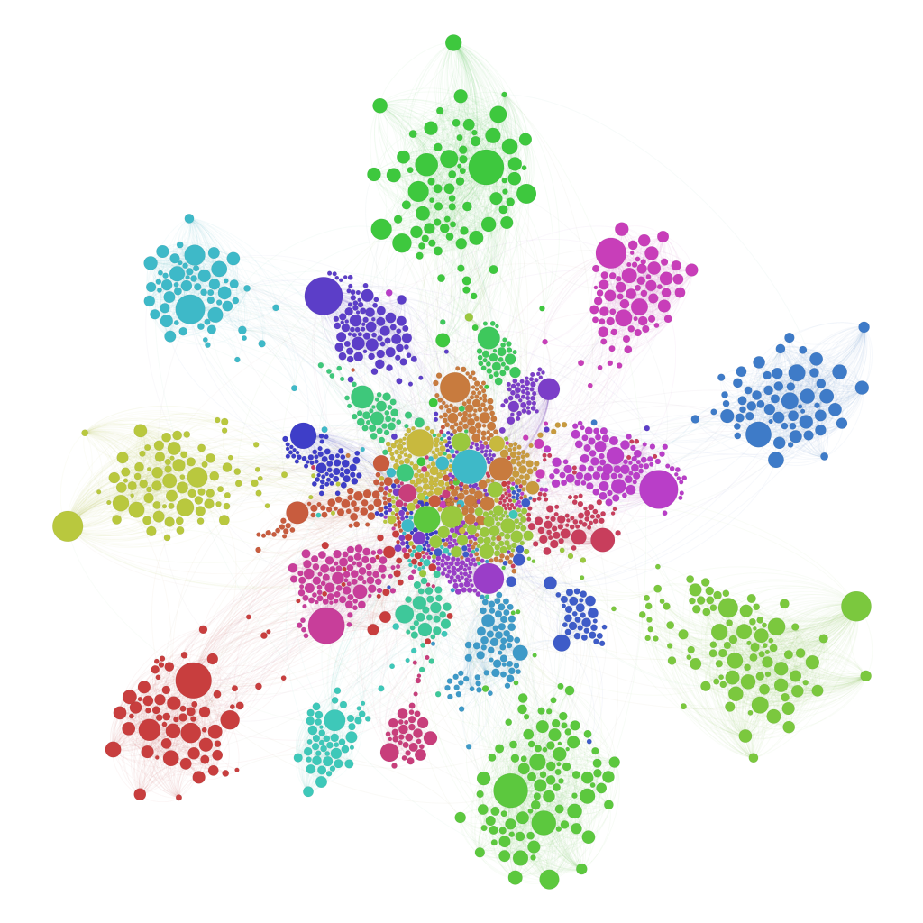

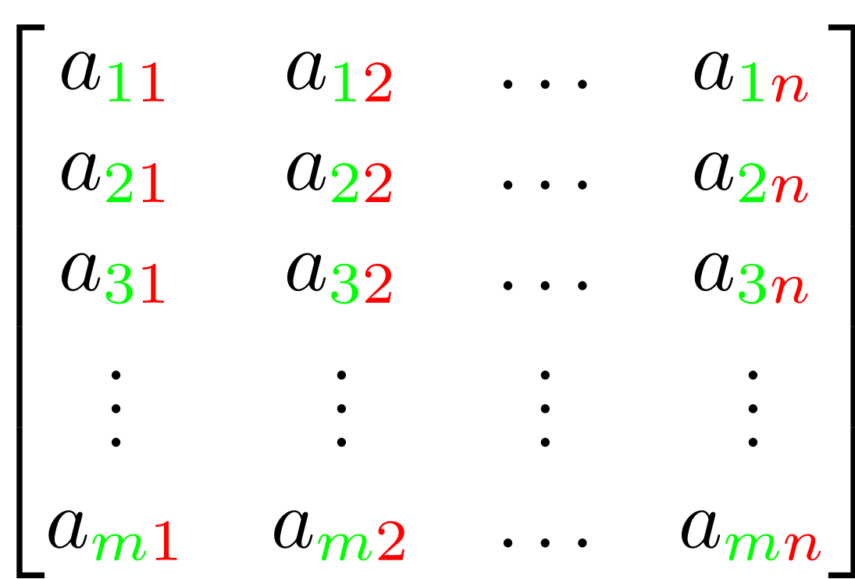
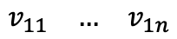
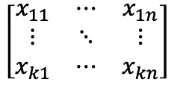
30K jobs posted on Indeed
Vectorized each job post
Job clusters
(aka. job categories)
Centers of the clusters
$$\left[\begin{matrix}x_{11} & ⋯ & x_{1n} \\ ⋮ & ⋱ & ⋮ \\ x_{k1} & ⋯ & x_{kn}\end{matrix}\right]$$
Top 5 best matched categories based on cosine similarity score
NLP pre-processing
Bag of words, tokenization, lemmatization, stop words removal, tf-idf weighting
K-means clustering
Extract topic (center) of each cluster
[
$$\begin{matrix}v_{11} & … & v_{1n}\end{matrix}$$
]
Notes:
To achieve this, I started from a dataset containing 30 thousands jobs posted on Indeed in 2019
Then I vectorize them using the bag of words model,
resulting in a matrix where each row is a job post, and each column is a feature
Then I used the k-means clustering to group them into 36 clusters, which represents 36 job categories,
And then I took the center of each cluster to represent its topic.
Ok, so this is how I came up with the categories of jobs
Now, a user comes and uploads his or her resume to this career explorer,
This resume will be transformed into a vector using the same NLP transformer.
And it will be compared with the job categories using cosine similarity.
And the top 5 best matched job categories will be returned to the user.
Next, I’ll walk you through a real application of this resume-based career explorer

Slide 5
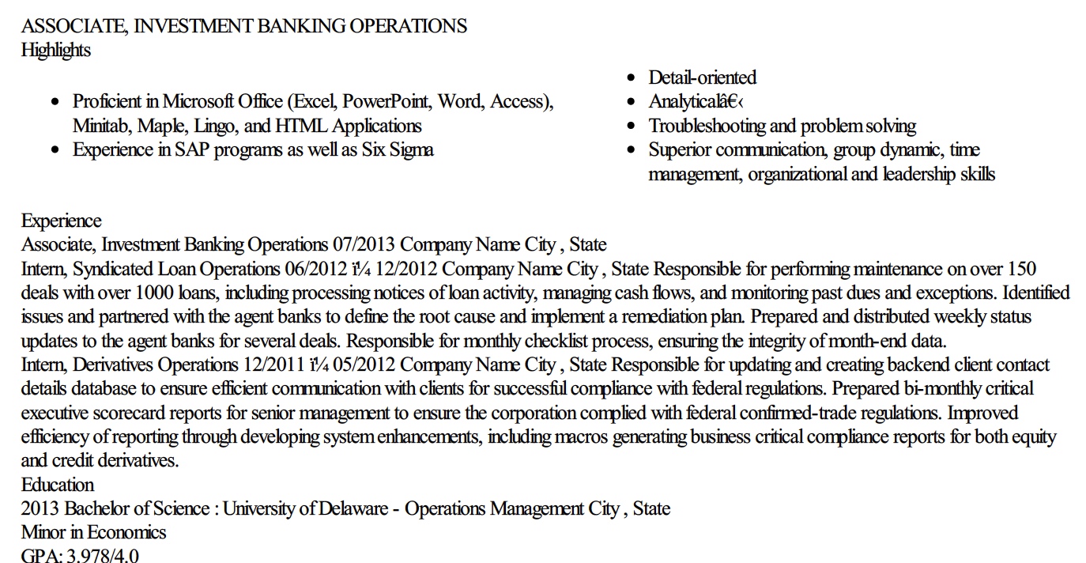
Input – Resume of a Banker
Notes:
Say we have a user who was a banker, and this is her resume
As you can see, besides banking, she also has others skills like proficiency in Maple and html application, communication with clients, federal regulations, business skills, and she also has degrees in operations management and economics
Now she wants to explore what types of jobs she can do with these assets. So she uploads the resume to our career explorer

Slide 6
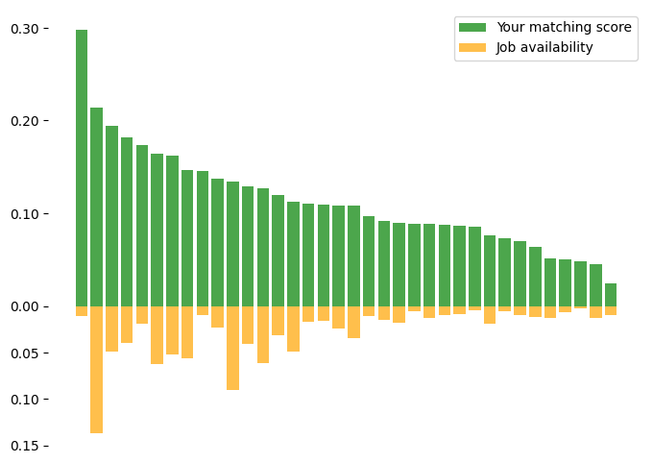
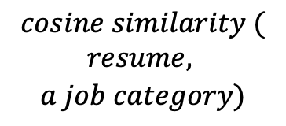
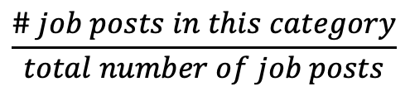
Result – All the Job Categories
(Not visible to users)
$$cosine similarity ($$
$$resume,$$
$$a job category)$$
$$\frac{\# job posts in this category}{total number of job posts}$$
Notes:
Under the hood, this is all the job categories sorted by the matching score with her resume, indicated by the green bars here.
The yellow bars pointing downwards indicate the availability of a corresponding job category,
Measured by the number of job posts in this category divided by the total number of job posts.
But There’s no need to show all the categories to the users.
Instead, we only return the top 5

Slide 7
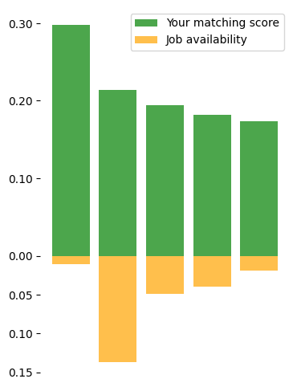
Output – Top 5 Job Categories
KEYWORDS
JOB TITLES
JOB POSTS
Notes:
And this is what the user will see
she can click each bar to get the information of that category, including keywords, job title, and job posts

Slide 8
Output – Top 5 Job Categories
KEYWORDS
branch, client, application, union, business, banking, realtor, underwriting, origination, service, borrower, financial, customer, originator, officer, lending, credit, bank, mortgage, loan
Notes:
For example, the Keywords that best represent this category are branch, client, banking, lending, loan, etc
Which are closely related to jobs in banking
Well this is not too interesting given that the resume IS about banking
What if our user wants to explore what ELSE she can do besides banking?
Then she can have a look at other categories that we recommend

Slide 9
Output – Top 5 Job Categories
KEYWORDS
JOB TITLES
JOB POSTS
Notes:
For example, if she clicks this bar

Slide 10
Output – Top 5 Job Categories
KEYWORDS
payment, invoice, accountant, ledger, monthly, report, finance, reconciliation, payroll, prepare, payable, account, tax, financial, accounting
Notes:
And take a look at the keywords, then she may realize that oh
Jobs that dealing with accounting, tax or payroll may also be relevant

Slide 11
Output – Top 5 Job Categories
KEYWORDS
JOB TITLES
Financial Analyst
Accounting Associate
Staff Accountant
Account Representative
Finance Manager
Business Manager
Entry Level Auditor
Senior Accounting Analyst
Notes:
And she can explore more by looking at the common job titles that fall within this category
And if she want’s to learn more about a specific title, for example, this entry level auditor,

Slide 12
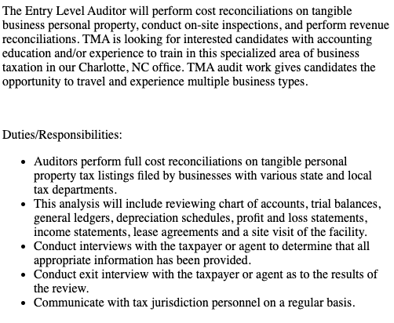
Output – Top 5 Job Categories
KEYWORDS
JOB TITLES
Entry Level Auditor
JOB POSTS
Notes:
Then she can click it, and check the original job post

Slide 13
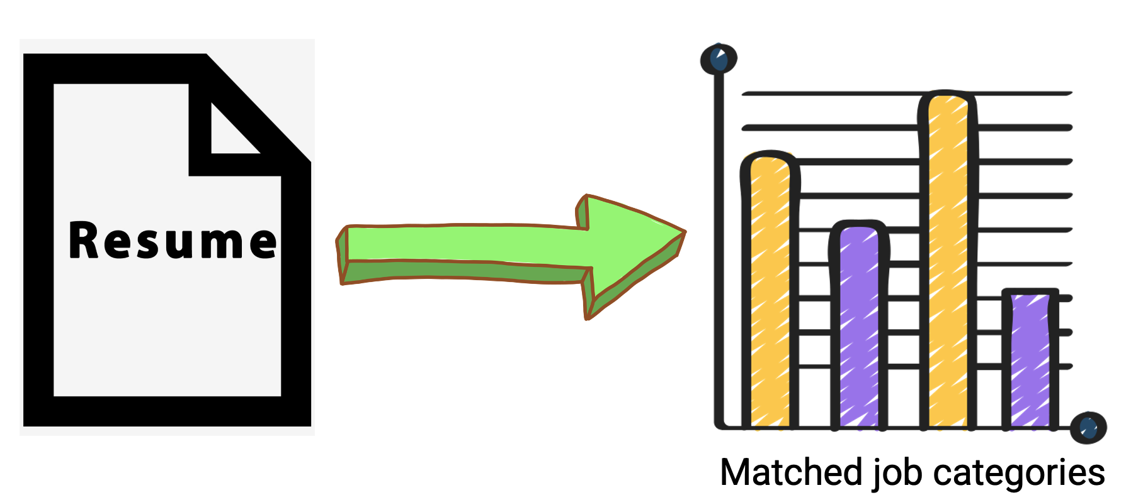
Resume-Based Career Explorer
Ying Yu
ying.yu@mg.thedataincubator.com
The web app is coming soon!
The Data Incubator Capstone Showcase
August 10, 2023
Notes:
With that, I’ll wrap up my presentation. I hope you like this resume-based career explorer,
Which Used a comprehensive and holistic description of the users’ career profile to search for the types of jobs that fit the user
Hopefully, it will provide the users with new career insights that they have not thought about before.
And its web application is coming soon. Stay tuned
Thank you for listening. Any questions?

Slide 15
Supplement slides

Slide 16
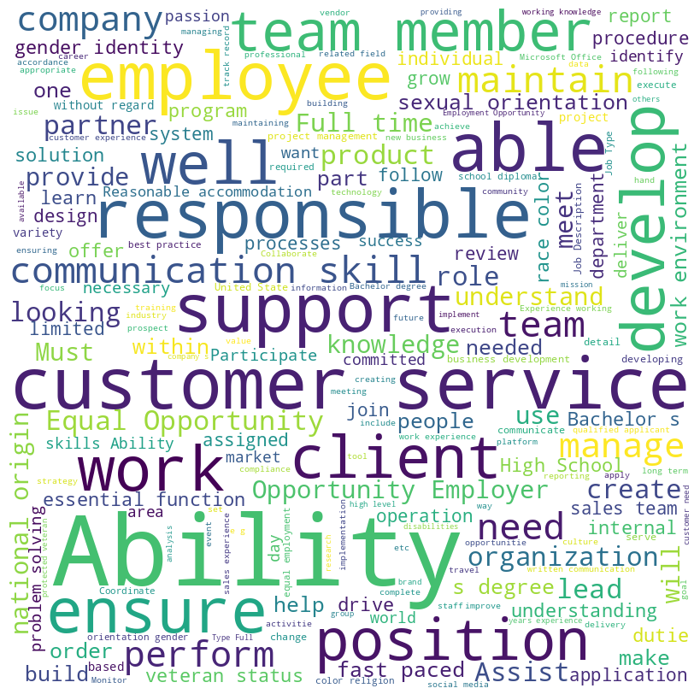
Job descriptions

Slide 17
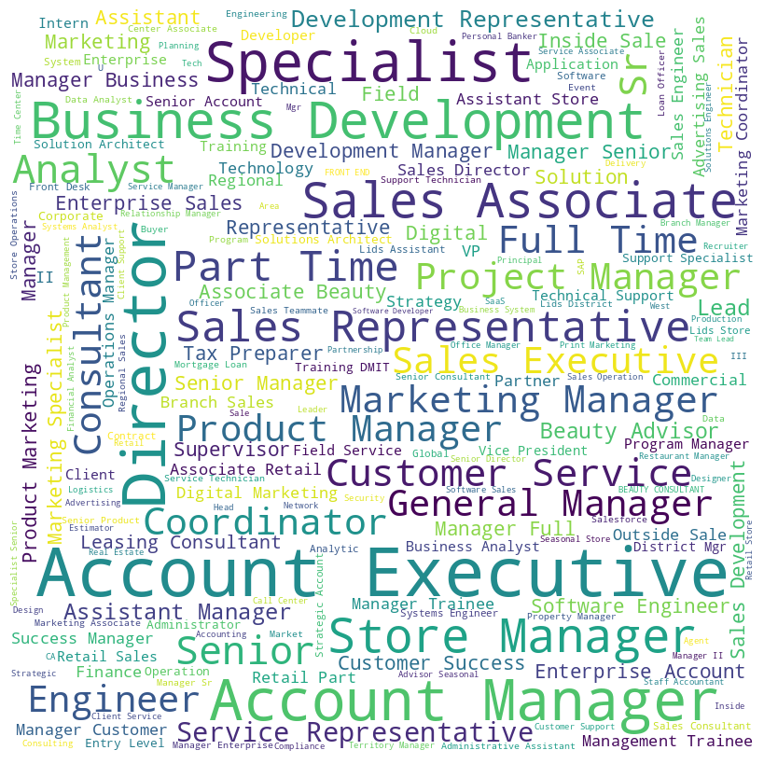
Job titles

Slide 18
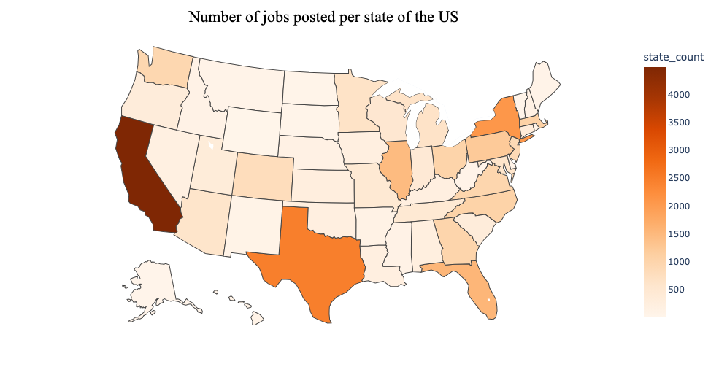

Slide 19
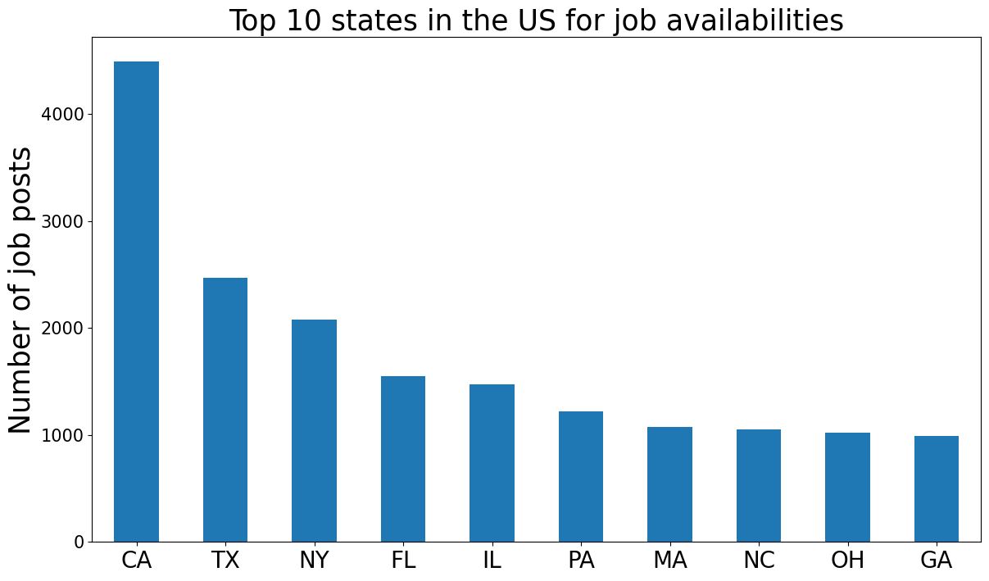

Slide 20
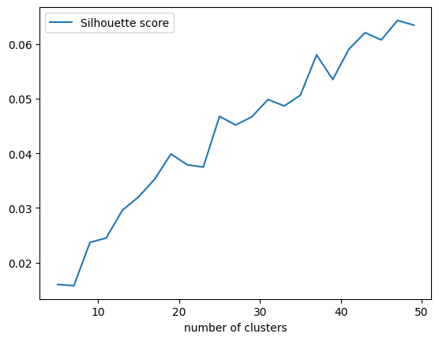

Slide 21
Bag of Words & k-means Clustering
Job description → Document → Vector
All the vectors → Clusters
Cleaning: lemmatizer, stopwords
Count Vectorizer
TF-IDf Transformer
K-means clustering
Center of each cluster
Top 20 components (words) of each center
K=10
Notes:
Consider each job description as a document, and clean the documents using lemmatizer and stopwords. Then I used "bag of words" model to vectorize each document with word counts and tf-idf weighting. Then I used k-means clustering to group these individual vector representations of job posts into clusters. Then I chose the top 20 components of the “center” of each cluster to represent the topic of that cluster. Here’s are the results for 10-clustering:

Slide 22
Future work
Phrases like “required,” “must have,” and “highly desired” mean what they say, so highlight those in your planning. Items further down the list or labeled “preferred” may be less important, even if you meet those standards. Pay particular attention to items under headers like “What We Are Looking For” and “What We Need.” Those are obviously direct hits.
Contextual search (ref. podcast)

